Slide 1
Changes in Capture Efficiency Due to Folding
A problem for MPI 2013
Worcester Polytechnic Institute
Matt Lucey and Yueyang Shen
June 17, 2013

Slide 2
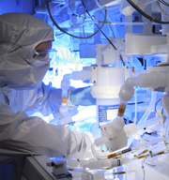
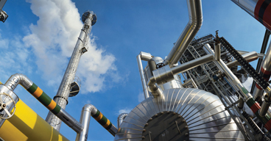
About Pall Corporation
Leader in Filtration, Separation and Purification
Scientific, technology and advanced engineering company
Founded in 1946
Global Footprint
Over 10,000 Employees
$2.7B Annual Revenue year ending Aug. 2012
Capture Efficiency Lucey & Shen June 17, 2013 2 of 10

Slide 3
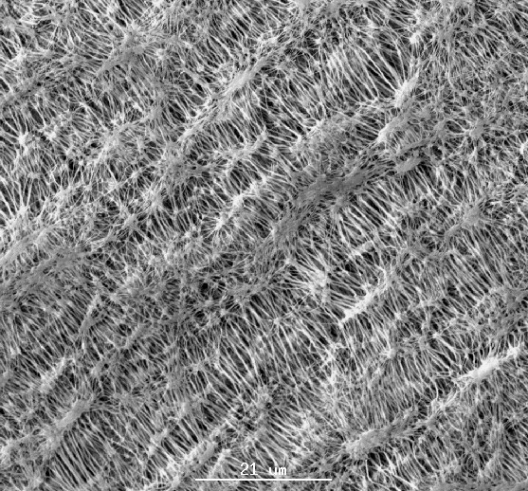
Cast and Expanded Membranes
Pall's cast and expanded membranes have the following benefits.
Micron efficiency rating from 100 µm down to ultrafiltration levels in liquids.
Fast flow rates resulting from highly porous and asymmetric structures.
Wide variety of polymer offerings.
Excellent chemical resistance, thermal characteristics, and surface treatments.
PTFE - Sample of Micro-Structure
Capture Efficiency Lucey & Shen June 17, 2013 3 of 10

Slide 4
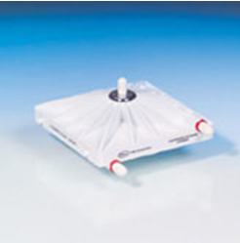
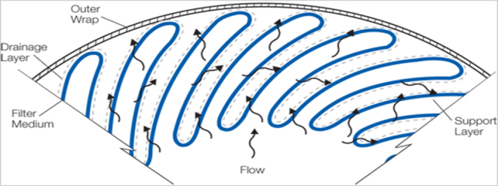
Media Applications
Flat Sheet Devices
Laid-Over Pleat (LOP) Cartridge
Contributions to Variable Performance for the Current Problem
Pre-stress of media during production
Plastic deformations from pleating
Creep – Relaxation
Temperature while Pleating – Phase Transition
Thickness of Media / Membranes (stack-up)
Capture Efficiency Lucey & Shen June 17, 2013 4 of 10

Slide 5
Problem Statements
How does large deformation of a membrane (PTFE) strip, with a 3D random ‘node-and-fibril’ distribution, affect the capture of particles?
What happens over time due to stress relaxation?
Assumptions
Mechanical Capture of Particles
Anisotropic Material in 2 directions – thickness is uniform
Non-Linear Material Behavior
Random Pore Size Distribution – 20 nanometers
Suspended Particles* are Mono-dispersed – 20 nanometers
Drainage and Support layers have no effect on capture
Drainage Material : Elastic Modulus = 50000 psi ; Poisson’s Ratio = 0**
* Liquid is DI water with surfactant
** The true value for Poisson’s Ratio actually depends on the orientation of the strands
Capture Efficiency Lucey & Shen June 17, 2013 5 of 10

Slide 6
A Brief Literature Survey
Hu-Hai Guo, et al. Journal of Applied Polymer Sciences, 116 (2010) 1124-1130
Described in details the two-step biaxial stretching operation for PTFE membrane preparation.
Proposed a FEA model to study the stress and displacement distribution of the biaxially stretched PTFE membrane.
Drawback: PTFE base sheet was considered mechanically isotropic. No structure information.
K Kurumada, et al. Journal of Membrane Sciences, 149 (1998) 51-57
Studied the morphology and its structure formation of the PTFE porous membranes fabricated through the steady-rate biaxial stretching operations.
Drawback: Only explanation but no modeling given for the generation of structure of PTFE.
K Evans, et al. Journal of Physics D: Applied Physics, 22 (1989) 1883-1887
Described a simple model for the PTFE microstructure to account for its highly anisotropic and negative Poisson's ratio.
Drawback: No allowance for material elasticity are considered in this model.
Reason to mention: good beginning point to build PTFE structure model.
Capture Efficiency Lucey & Shen June 17, 2013 6 of 10

Slide 7
A Brief Literature Survey
T Suwa, et al. Journal of Applied Polymer Science, 17 (1973) 3253-3257
Melting and crystallization behavior of the virgin PTFE was studied using a DSC.
Reason to mention: heating and cooling process are involved during PTFE manufacturing and pleating process.
E Brown, et al. Polymer, 48 (2007) 2531-2536
Described temperature-pressure phase behavior of crystalline PTFE.
PTFE shown to respond to uniaxial deformation by undergoing a crystalline phase transition.
Detailed Teflon PTFE bulk properties:
http://www.rjchase.com/ptfe_handbook.pdf
Capture Efficiency Lucey & Shen June 17, 2013 7 of 10

Slide 8
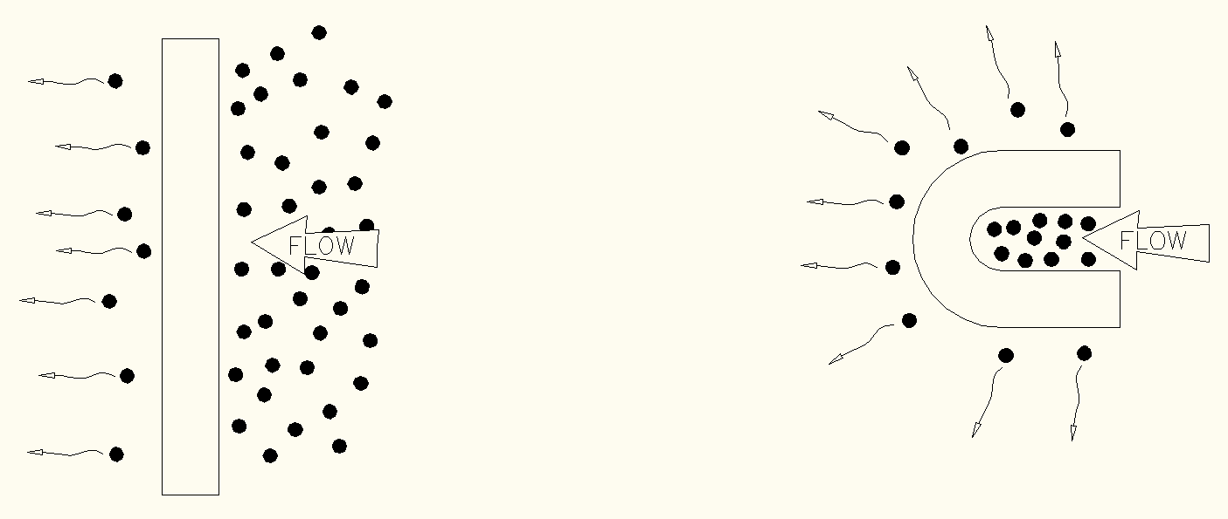
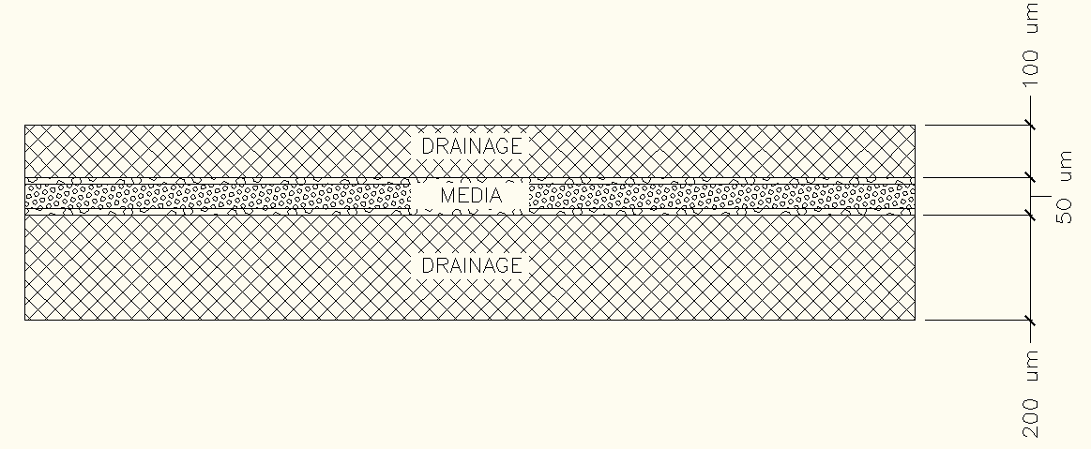
Problem Schematics
What happens in the deformed region?
Neutral Axis Shift depending on layer thicknesses
Simple Bending
Membrane Tension
Membrane Compression
Capture Efficiency Lucey & Shen June 17, 2013 8 of 10

Slide 9
Schematic of Challenge Particles Trapped by PTFE Membranes
PTFE Fibrils
PTFE Nodes
Challenge
Particles
Capture Efficiency Lucey & Shen June 17, 2013 9 of 10

Slide 10
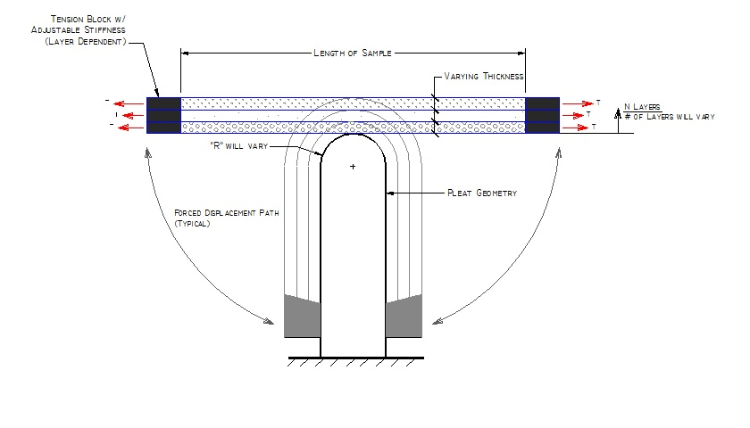
Schematic of an FEA Model
Capture Efficiency Lucey & Shen June 17, 2013 10 of 10

